Slide 1


Bruno Candido
28/10/2022

Slide 2

Outline
Executive Summary
Introduction
Methodology
Results
Conclusion
Appendix

Slide 3
Executive Summary
Summary of methodologies
Data Collection using API
Data Collection with Web Scraping
Data Wrangling
Exploratory Data Analysis with SQL
Exploratory Data Analysis with Data Visualization
Interactive Visual Analytics with Folium
Machine Learning Prediction
Summary of all results
Exploratory Data Analysis result
Interactive analytics in screenshots
Predictive Analytics result

Slide 4
Introduction
Project background and context
SpaceX advertises Falcon 9 rocket launches on its website with a cost of 62 million dollars; other providers cost upwards of 165 million dollars each, much of the savings is because SpaceX can reuse the first stage. Therefore, if we can determine if the first stage will land, we can determine the cost of a launch.
This goal of the project is to create a machine learning pipeline to predict if the first stage will land successfully by determining the price of each launch.
Problems you want to find answers
What factors determine if the rocket will land successfully?
The interaction amongst various features that determine the success rate of a successful landing.
What operating conditions needs to be in place to ensure a successful landing program.

Slide 5

Section 1

Slide 6
Methodology
Executive Summary
Data collection methodology:
Space X API and web scraping from Wikipedia.
Perform data wrangling
One-hot encoding was applied to categorical features
Perform exploratory data analysis (EDA) using visualization and SQL
Perform interactive visual analytics using Folium and Plotly Dash
Perform predictive analysis using classification models
How to build, tune, evaluate classification models

Slide 7
Data Collection
Describe how data sets were collected.
Data collection was done using get request to the SpaceX API.
Next, we decoded the response content as a Json using .json() function call and turn it into a pandas dataframe using .json_normalize().
We then cleaned the data, checked for missing values and fill in missing values where necessary.
In addition, we performed web scraping from Wikipedia for Falcon 9 launch records with BeautifulSoup.
The objective was to extract the launch records as HTML table, parse the table and convert it to a pandas dataframe for future analysis.

Slide 8
Data Collection – SpaceX API
Get request to the SpaceX API to collect launch data, normalize json data, clean the requested data and some basic data wrangling and formatting.
GitHub URL: https://github.com/brunocandido/spacey/blob/main/week1_Data_Collection_API.ipynb
Request API and parse SpaceX launch data
Use json_normalize to convert data into a table format
Data cleasing and filling in missing values

Slide 9
Data Collection – Scraping
Data from SpaceX launches can also be obtained from Wikipedia;
Data are downloaded from Wikipedia according to the flowchart and then persisted.
GitHub URL: https://github.com/brunocandido/spacey/blob/main/week1_Data_Collection_with_Web_Scraping.ipynb
Request the Falcon9 Launch Wiki page
Extract all variable names from the HTML table header
Create a data frame by parsing the launch HTML tables

Slide 10
Data Wrangling
Performed exploratory data analysis and determined the training labels.
Calculated the number of launches at each site, and the number and occurrence of each orbits.
Created landing outcome label from outcome column and exported the results to csv.
GitHub URL: https://github.com/brunocandido/spacey/blob/main/week1_Data_Wrangling.ipynb
EDA
Summarizations
Creation of Landing Outcome Label

Slide 11
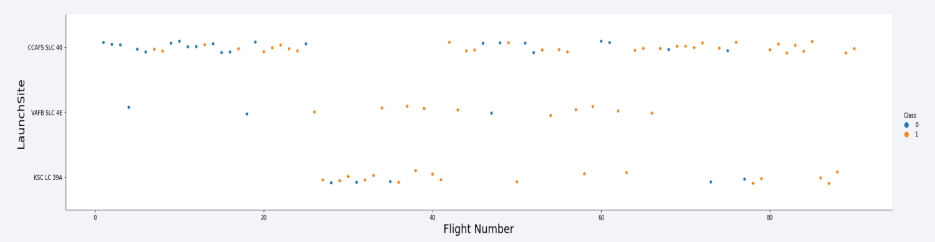
EDA with Data Visualization
Visualizing the relationship between flight number and launch Site, payload and launch site, success rate of each orbit type, flight number and orbit type, the launch success yearly trend.
GitHub URL: https://github.com/brunocandido/spacey/blob/main/week2_EDA_with_Data_Viz.ipynb

Slide 12
EDA with SQL
The following SQL queries were performed:
Names of the unique launch sites in the space mission;
Top 5 launch sites whose name begin with the string 'CCA’; Total payload mass carried by boosters launched by NASA(CRS);
Average payload mass carried by booster version F9 v1.1;
Date when the first successful landing outcome in ground pad was achieved;
Names of the boosters which have success in drone ship and have payload mass between 4000 and 6000 kg;
Total number of successful and failure mission outcomes;
Names of the booster versions which have carried the maximum payload mass;
Failed landing outcomes in drone ship, their booster versions, and launch site names for in year 2015; and
Rank of the count of landing outcomes (such as Failure (drone ship) or Success (ground pad)) between the date 2010-06-04 and 2017-03-20.
GitHub URL: https://github.com/brunocandido/spacey/blob/main/week2_EDA_with_SQL.ipynb

Slide 13
Build an Interactive Map with Folium
Markers, circles, lines and marker clusters were used with Folium Maps
Markers indicate points like launch sites;
Circles indicate highlighted areas around specific coordinates, like NASA Johnson Space Center;
Marker clusters indicates groups of events in each coordinate, like launches in a launch site;
Lines are used to indicate distances between two coordinates.
GitHub URL: https://github.com/brunocandido/spacey/blob/main/week3_Interactive_Visual_Folium.ipynb

Slide 14
Build a Dashboard with Plotly Dash
We built an interactive dashboard with pie charts showing the total launches by a certain sites and scatter graph showing the relationship with Outcome and Payload Mass (Kg) for the different booster version.
This combination allowed to quickly analyze the relation between payloads and launch sites, helping to identify where is best place to launch according to payloads.
GitHub URL: https://github.com/brunocandido/spacey/blob/main/spacex_dash_app.py

Slide 15
Predictive Analysis (Classification)
Data was loaded using numpy and pandas, transformed, and splitted into training and testing.
Four machine learning models were built: logistic regression, support vector machine, decision tree and k-nearest neighbors.
We used accuracy as the metric for our model, improved the model using feature engineering and algorithm tuning.
We found the best performing classification model.
GitHub URL: https://github.com/brunocandido/spacey/blob/main/week4_Machine_Learning_Prediction.ipynb
Data preparation and split into training and testing
Build different machine learning models and tune them
Compare results

Slide 16
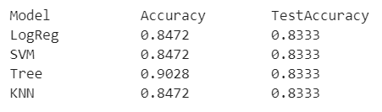
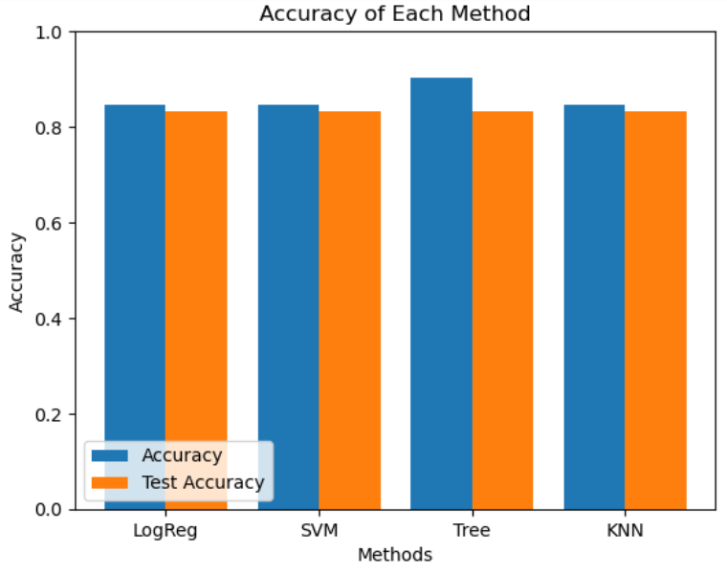
Results
Predictive Analysis showed that Decision Tree Classifier is the best model to predict successful landings, having accuracy of 90,28% and accuracy for test data of 83,33%.

Slide 17

Section 2

Slide 18
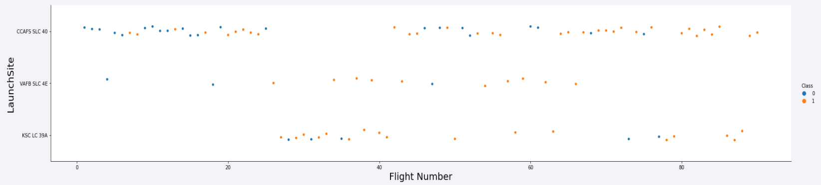
Flight Number vs. Launch Site
We can say that the most successful launch site is CCAF5 SLC 40, followed by VAFB SLC 4E site and KSC LC 39A in third place.
We can say also that the general success rate improves over time.

Slide 19
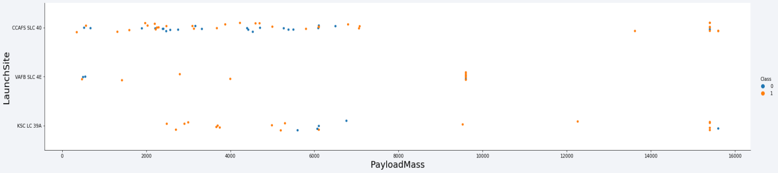
Payload vs. Launch Site
Payloads over 8,000 kg have excellent success rate.
It seems that VAFB SLC 4E site can’t launch payloads over 10,000 kg.

Slide 20
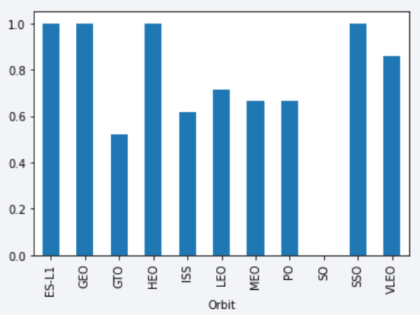
Success Rate vs. Orbit Type
The best success rate orbits are ES-L1, GEO, HEO, SSO;
The worst success rate orbit is GTO;
There was no success launch (or no launch at all) for SO orbit.

Slide 21
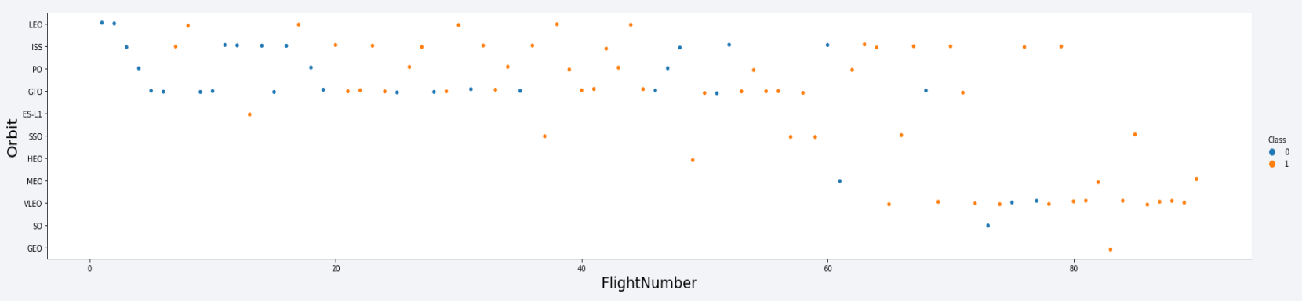
Flight Number vs. Orbit Type
Success rate improved over time to all orbits;
VLEO orbit seems a new business opportunity, due to recent increase of its frequency.

Slide 22
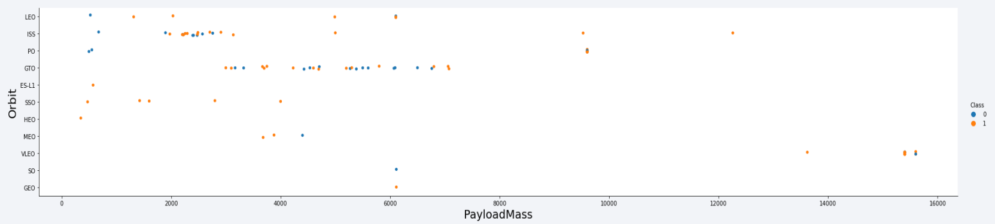
Payload vs. Orbit Type
It seems that there is no relation between payload and success rate to orbit GTO;
VLEO orbit works with huge payload mass;
There are few launches to the orbits SO and GEO.

Slide 23
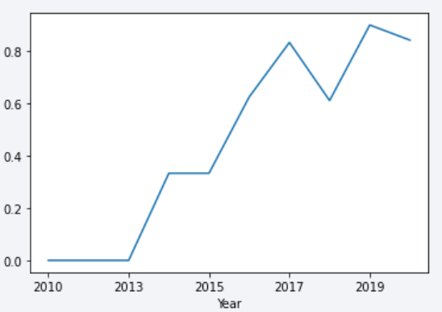
Launch Success Yearly Trend
Apparently, the first three years were a period of adjusts and improvement of technology.
Success rate started increasing in 2013 and kept until 2020;
It seems that they had some difficulties in 2018.

Slide 24
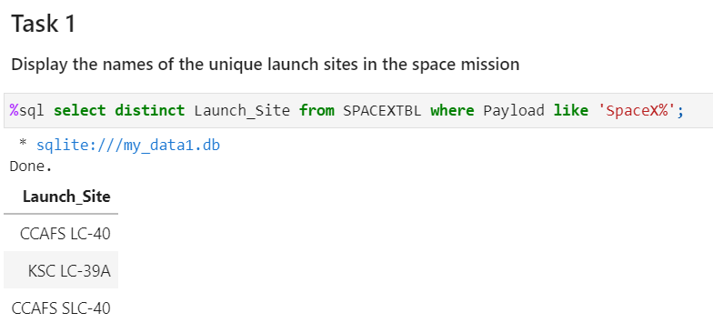
All Launch Site Names
There are three launch sites in database.

Slide 25
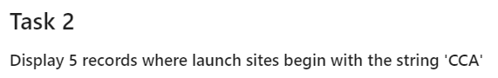
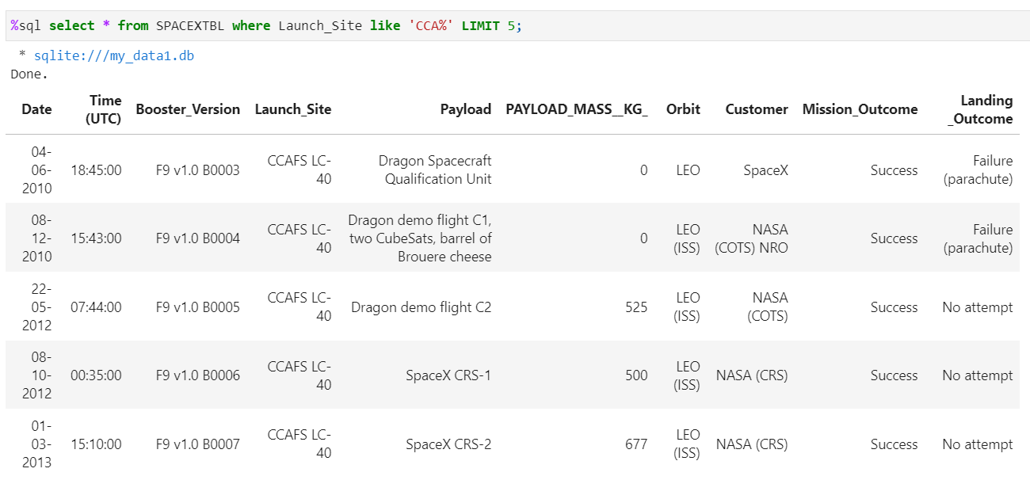
Launch Site Names Begin with 'CCA'
We can see five samples of Cape Canaveral launches.

Slide 26
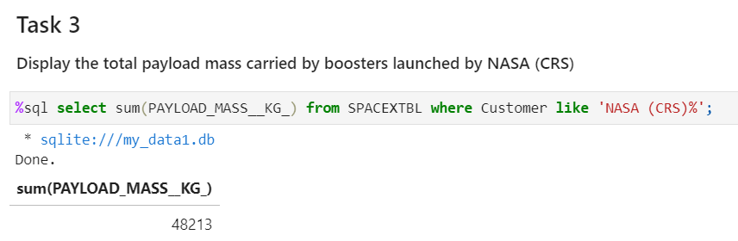
Total Payload Mass
Total payload calculated by summing all payloads whose codes contain ‘NASA (CRS)’. Result: 48,213 kg.

Slide 27
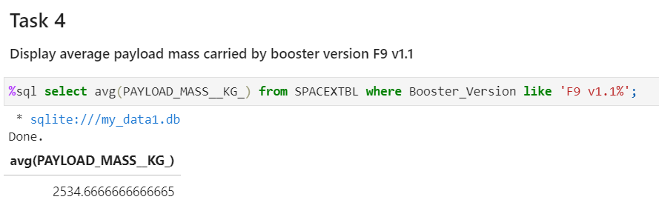
Average Payload Mass by F9 v1.1
Filtering data by the booster version above and calculating the average payload mass we obtained the value of 2,534 kg.

Slide 28
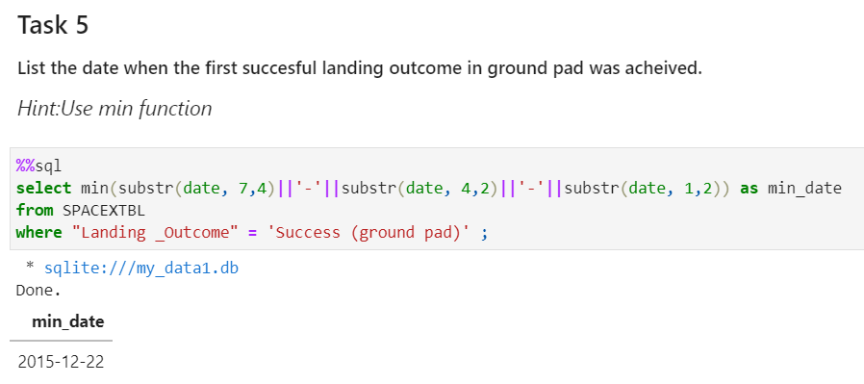
First Successful Ground Landing Date
The first successful ground landing date is 22-Dec-2012.
We had to slice the date in substrings starting with year, then month and day at last.

Slide 29
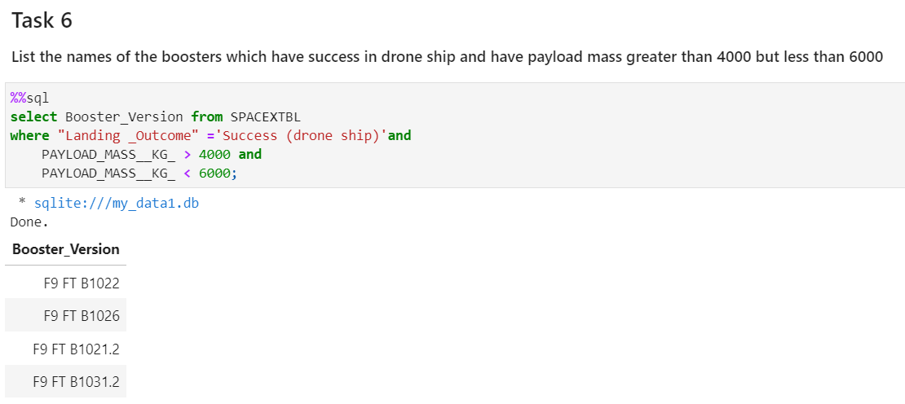
Successful Drone Ship Landing with Payload between 4000 and 6000
These are the four boosters which have successfully landed on drone ship and had payload mass greater than 4000 but less than 6000.

Slide 30
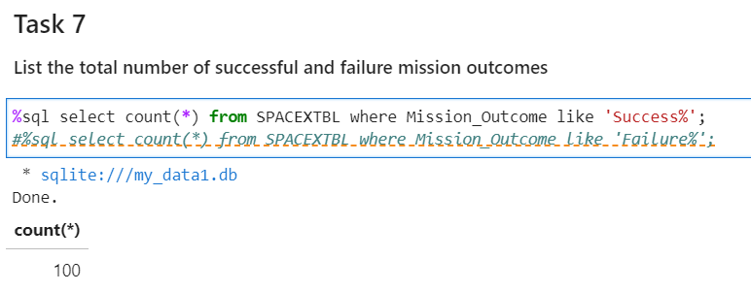
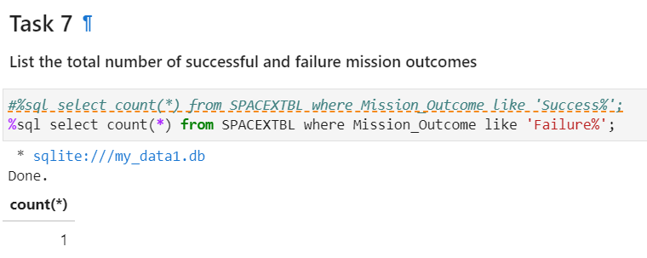
Total Number of Successful and Failure Mission Outcomes
We built a query to answer the number of successful mission outcomes, and another to answer the number of failures.
There were 100 successful and just 1 failure mission outcomes.

Slide 31
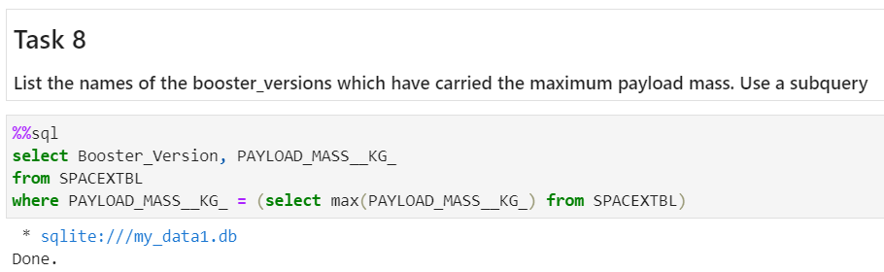
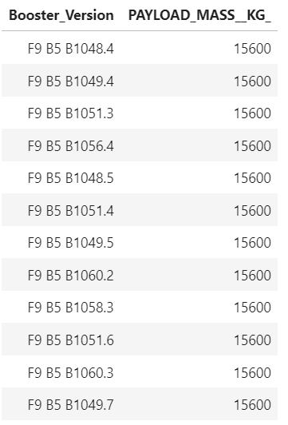
Boosters Carried Maximum Payload
These are the boosters which have carried the maximum payload mass.

Slide 32
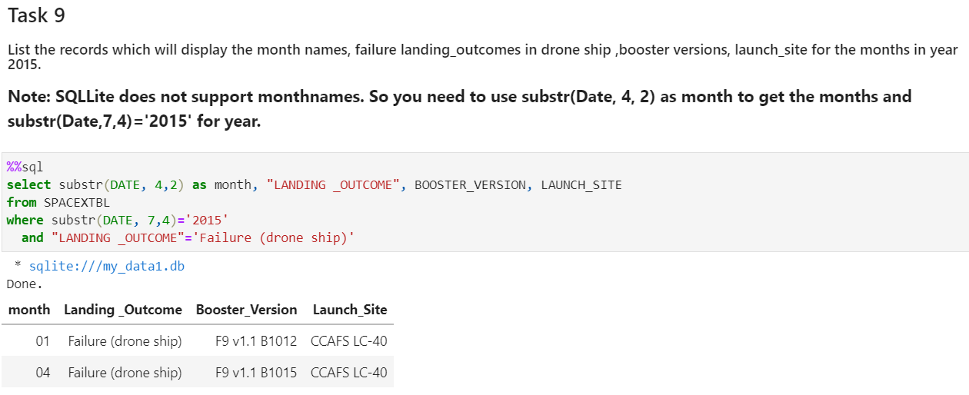
2015 Launch Records
Failed landing outcomes in drone ship, their booster versions, and launch site names for in year 2015

Slide 33
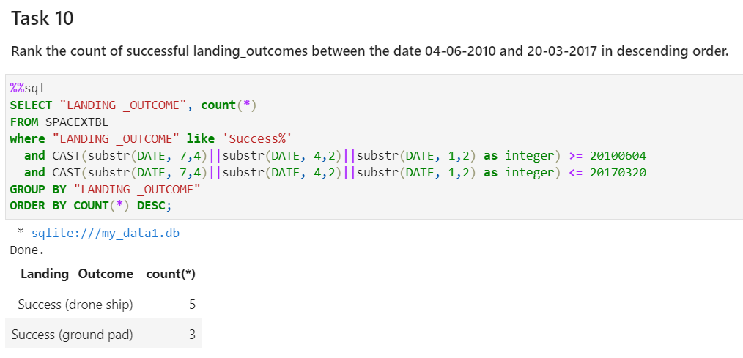
Rank Landing Outcomes Between 2010-06-04 and 2017-03-20
There were 5 success drone ship and 3 ground pad landing outcomes between the date 2010-06-04 and 2017-03-20.

Slide 34

Section 3

Slide 35
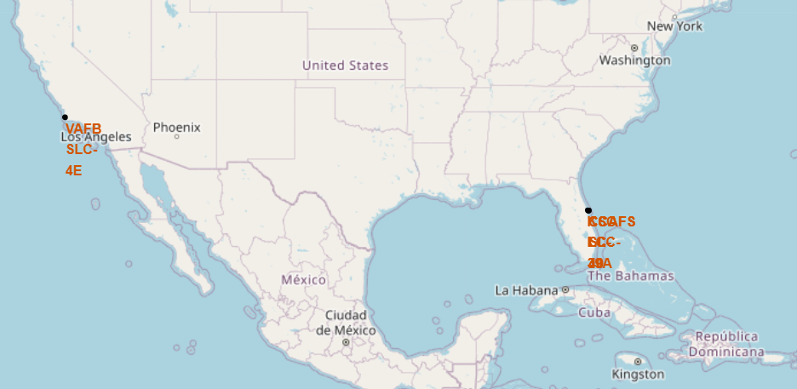
All launch sites on a global map
We can see that Space X launch sites are in the USA coasts – Florida and California – probably for safety reasons.

Slide 36
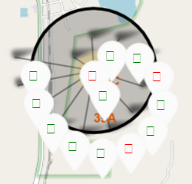
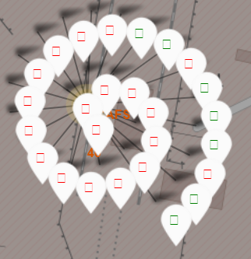
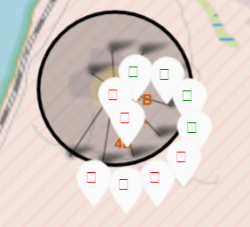
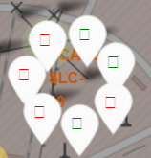
Launch Outcomes by Site
KSC LC-39A
CCAFS LC-40
VAFB SLC-4E
CCAFS SLC-40
Florida Launch Sites
California Launch Sites
Green Marker shows successful launches and Red Marker shows failures.

Slide 37
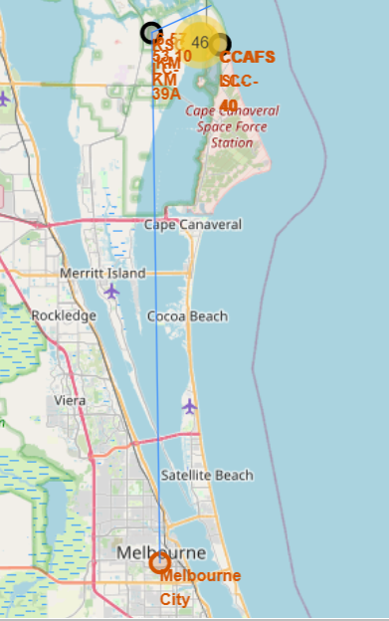
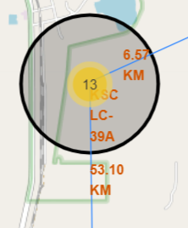
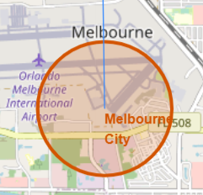
Launch Site distance to landmarks
KSC LC-39A Launch Site is 53,10 KM far from Melbourne City.

Slide 38

Section 4

Slide 39
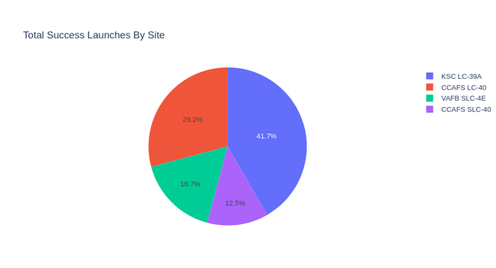
Successful launches by Site
KSC LC-39A launch site is where most of success launches took place, whereas CCAFS SLC-40 is the one that least successful launches took place.

Slide 40
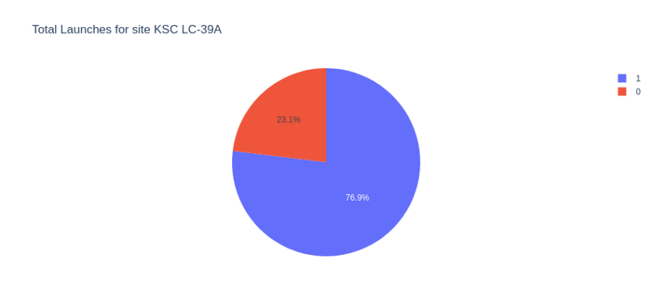
Launch Success Ratio for KSC LC-39A
76.9% of launches are successful in this site.

Slide 41
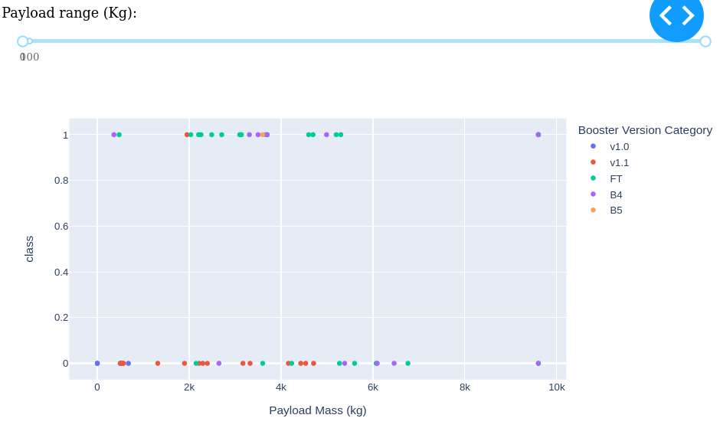
Payload vs. Launch Outcome
FT boosters with payloads between 2,000kg and 6,000kg are the most successful combination.
It seems that v1.1 boosters weren’t a good project, regardless of payload mass.

Slide 42

Section 5

Slide 43
Classification Accuracy
Decision Tree Classifier has the highest classification accuracy among all four machine learning models compared, having accuracy over than 90%.

Slide 44
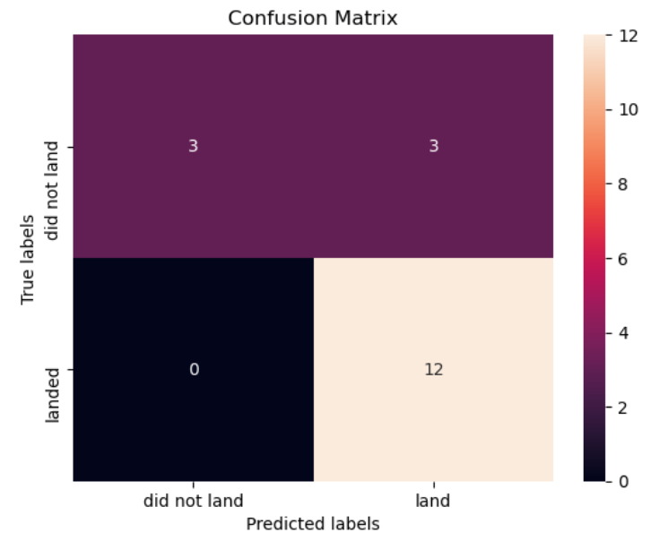
Confusion Matrix
The confusion matrix for the decision tree classifier shows that the classifier can distinguish between the different classes.
The major problem is the false positives .i.e., unsuccessful landing marked as successful landing by the classifier.

Slide 45
Conclusions
The best launch site is KSCLC-39A.
The larger the flight amount at a launch site, the greater the success rate at a launch site.
Although most of mission outcomes are successful, successful landing outcomes seem to improve over time, according the evolution of processes and rockets.
Orbits ES-L1, GEO, HEO and SSO had the most success rate.
The Decision Tree Classifier is the best machine learning algorithm for this task.

Slide 46
Appendix
No appendix was needed.

Slide 47


